Slide 1
布料

Slide 2
rewrite of the PhysX 2 deformables, tailored towards simulating character cloth
Softbodies, tearing, two-way interaction, and world collision have been removed, while behavior and performance for cloth simulation have been improved.

Slide 3
Cloth Creation Overview
The cloth constraint connectivity and rest values are stored in a fabric instance (PxClothFabric)
separate from the cloth actor (PxCloth)
PxClothFabricCreate, in the extensions library, creates a fabric from a triangle or quad mesh (see PxClothMeshDesc)
The cloth actor itself is created through the physics instance (PxPhysics) and needs to be added to a scene (PxScene) in order to be simulated
Once the cloth actor is created, users can assign simulation settings such as collision data, constraint stiffness, solver frequency and self-collision
Notes:
). The separation of the constraints from particles allows the same fabric data to be reused for multiple cloth instances, reducing cooking time and storage requirements.

Slide 4
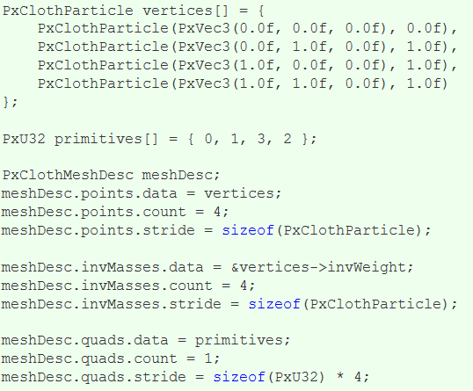
Filling in PxClothMeshDesc
The first task to create a cloth is to fill in the PxClothMeshDesc structure

Slide 5
Each particle is defined by its position in local coordinates and its inverse mass
Setting the inverse mass to zero indicates that the particle is not simulated
Instead, the particle is fixed in local space or kinematically constrained to user specified positions
The inverse mass of simulated particles can normally be set to any fixed positive value.
The PxClothMeshDesc structure allows positions and inverse masses stored in separate arrays or interleaved like in the code above
The mesh can consist of quads or triangles, or both
Notes:
. The cooker prefers quad meshes over triangle meshes when creating constraints and classifying constraint types. The extensions library therefore provides the PxClothMeshQuadifier helper class to extract quads from a triangle mesh.

Slide 6
Creating Fabric
Given the mesh descriptor, a call to PxClothFabricCreate in the extensions library wraps the generation of constraints and the creation of the PxClothFabric structure:
PxClothFabric* fabric = PxClothFabricCreate(physics, meshDesc, PxVec3(0, -1, 0));
The third parameter indicates the direction of gravity, which is used as a hint to determine the direction of 'horizontal' or 'vertical' constraints
The PxClothFabric class describes internal solver data for a cloth
Notes:
. For example, distance constraints consisting of two particle indices and a rest-length are created by the cooker and stored in the fabric data. Multiple cloth instances of the same mesh can share a single fabric instance.

Slide 7
Creating Cloth
A PxCloth object is created using a fabric instance and the initial particle configuration. the cloth instance is simulated as part of a scene:
PxTransform pose = PxTransform(1.0f);
PxCloth* cloth = physics.createCloth(pose, fabric, vertices, PxClothFlags());
scene.addActor(cloth);

Slide 8
Simulation Overview
For one PhysX simulation frame, the cloth solver runs for multiple iterations
The number of iterations is determined by the solver frequency parameter and the simulation frame time
Each iteration integrates particle positions, solves constraints, and performs character and self-collision. Cloth inter-collision is performed once per-frame after all cloth instances in the scene have been stepped forward
Local frame, motion constraints and collision shapes are interpolated per iteration from the per-frame values specified by the user

Slide 9
Particle Integration
A particle state consists of the current position and the position before the last iteration
The size of time step is inversely proportional to the number of solver iterations:
cloth.setSolverFrequency(240.0f);
In general, simulation will become more accurate if higher solver frequency value is used. However, simulation time grows roughly linearly with solver frequency. Typically this value is between 120 and 300.
Notes:
The solver frequency is specified as iterations per second. A solver frequency value of 240 corresponds to 4 iterations per frame at 60 frames per second.

Slide 10
Distance Constraints
One of the most important roles for the cloth solver is to maintain distance between particles so that the cloth does not stretch
This is achieved by applying distance constraints between pairs of particles
The way particles are connected affects how the cloth stretches, compresses, shears, rotates, and bends
PhysX classifies distance constraints into 4 types (see PxClothFabricPhaseType), each of which can be configured with different stiffness parameters.
Note that stretch settings for horizontal and vertical directions are specified separately. This can be used to handle stretching along the gravity (vertical) direction differently

Slide 11
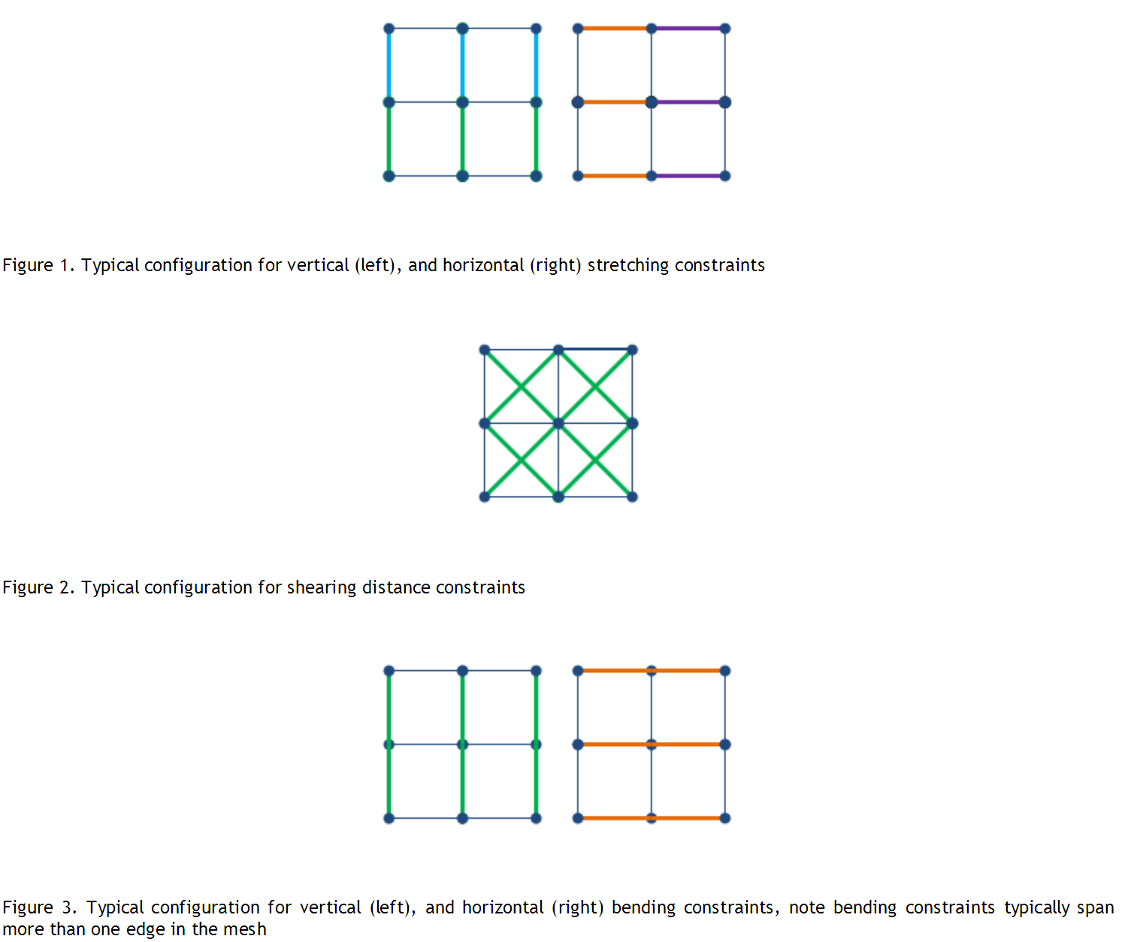

Slide 13
Sometimes it is desirable that distance constraints are not enforced rigorously
The stiffness parameter allows only correcting a portion of the edge length residual per iteration
for example to reduce the strength of bending constraints. A separate, lower stiffness can be used for edges that are only moderately stretched or compressed
For example, a dress can be made to stretch when the character is taking large steps, but still behave correctly during pirouettes

Slide 14
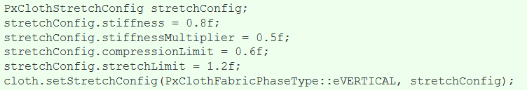
The following code sets up the vertical constraints such that when edges are compressed more than 60% or stretched more than 120%, a stiffness of 0.8 will be used. Otherwise a stiffness of 0.4 = 0.8 * 0.5 will be used:

Slide 15
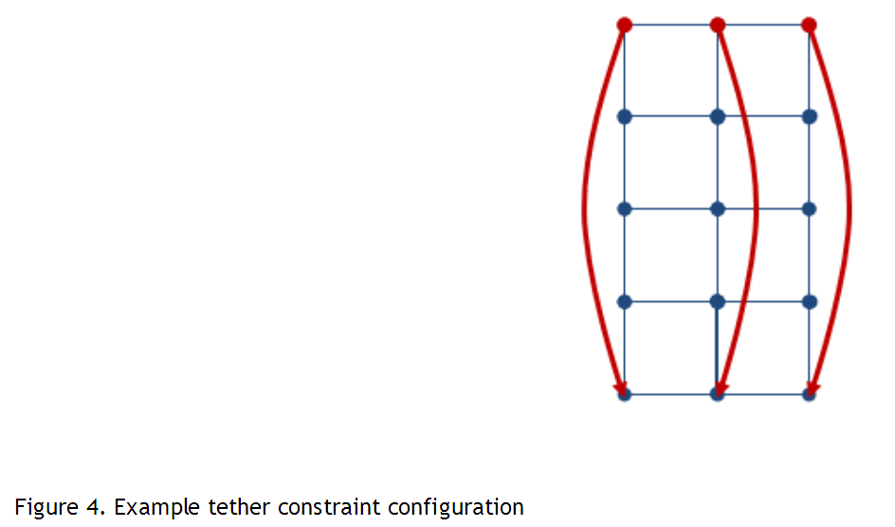
Tether Constraints

Slide 16
The distance constraints are solved only once per iteration without converging completely
PhysX 3.3 introduces tether constraints as a solution to avoid stretchiness under gravity or fast motion
Tether constraints prevent stretching by limiting the distance a particle can move away from their anchor particles
The tether constraints are automatically generated by the cooker when some PxClothMeshDesc::invMasses values are set to zero, telling the cooker that the corresponding particles are non-simulated anchor particles whose positions are provided solely from users. Changing inverse masses after the fabric has been created does not affect which anchor particles are used for the tether constraints.

Slide 17
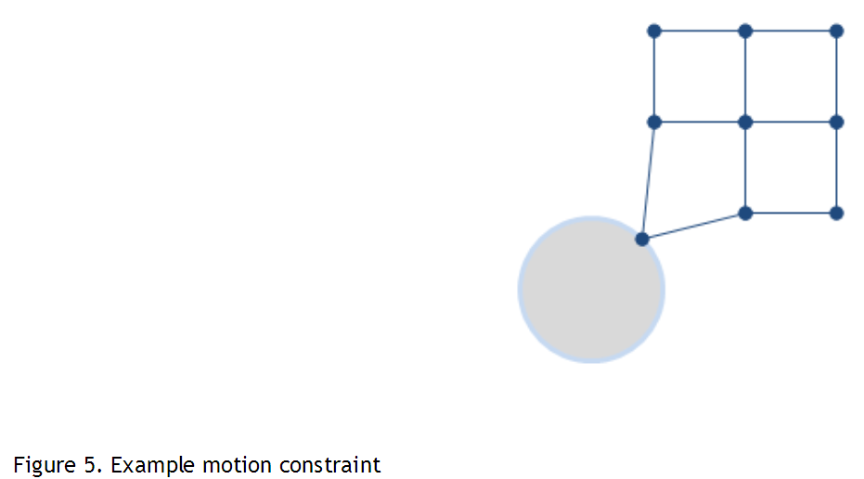
Motion Constraints

Slide 18
One can fully constrain a point to user specified position with zero inverse mass. However, it is sometimes desirable to confine a point within small region around the animated (user specified) position. This allows small details to be generated by simulation, while suppressing any excessive deviation from the desired position.
Motion constraints lock the movement of each particle inside a sphere. For example, an animation system can sketch the overall movement of a cloth while the fine scale details are handled by the cloth simulation

Slide 19
PxClothParticleMotionConstraint structure holds the position and radius of the sphere for each particle, and motion constraints can be specified as follows:
PxClothParticleMotionConstraints motionConstraints[] = {
PxClothParticleMotionConstraints(PxVec3(0.0f, 0.0f, 0.0f), 0.0f),
PxClothParticleMotionConstraints(PxVec3(0.0f, 1.0f, 0.0f), 1.0f),
PxClothParticleMotionConstraints(PxVec3(1.0f, 0.0f, 0.0f), 1.0f),
PxClothParticleMotionConstraints(PxVec3(1.0f, 1.0f, 0.0f), FLT_MAX)
};
cloth.setMotionConstraints(motionConstraints);

Slide 20
If the sphere radius becomes zero or negative, the corresponding particle is locked at the sphere center and the inverse particle mass is set to zero for the next iteration
In the above example, the first particle will fully lock to the constraint position, while the second and third particle will remain within the sphere radius. The last particle will not be constrained.

Slide 21
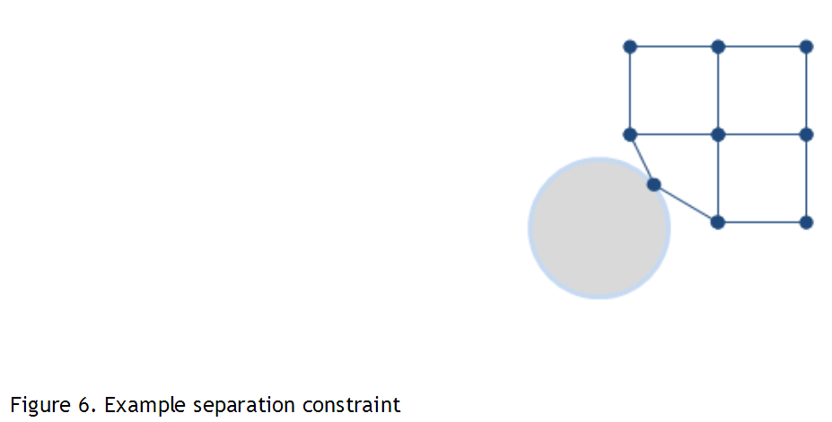
Separation Constraints

Slide 22
Separation constraints work exactly the opposite way to the motion constraints, forcing a particle to stay outside of a sphere
When particle movement is moderately constrained by motion constraints (e.g. sleeves around an arm), separation constraints can be used to represent the character's collision shape more accurately than using capsules alone
For example, separation constraints can be placed slightly inside the character by setting the radius to be the distance from the sphere center to the surface of the character.

Slide 23
Cloth Collision
Each cloth object supports collision with spheres, capsules, planes, convexes (groups of planes) and triangles
By default these shapes are all treated separately from the main PhysX rigid body scene
collision against other PxScene actors can be enabled using the PxClothFlag::eSCENE_COLLISION.
Collision shapes are specified in local coordinates for the next frame before simulating the scene
Capsules are defined by a pair of indices into the spheres array and each sphere may have a different radius thus forming a tapered capsule
Spheres can be shared between multiple capsules
Notes:
, which can be useful for modelling characters (upper and lower leg made up from capsules can share the sphere at the knee). Sharing of spheres also makes the simulation more efficient and robust, so is highly encouraged. The following code illustrates how to add two spheres of different radius and create a tapered capsule between them:

Slide 24
Creating Cloth Collision Data
PhysX 3 cloth does not collide with rigid bodies
Instead, each cloth object supports collision with spheres, capsules, planes and convex shapes (groups of planes)
these shapes are all treated separately to the main PhysX rigid body scene.
Sphere and capsule shapes must be specified at cloth construction time

Slide 25
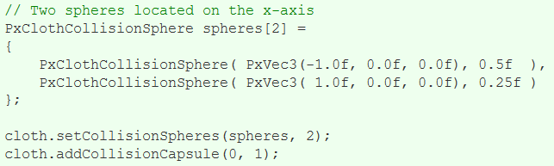
The following code illustrates how to add two spheres of different radius and create a tapered capsule between them:

Slide 26
Planes can be added through PxCloth::addCollisionPlane() method but will not be considered for collision unless they are referenced by a convex shape
Notes:
. For example, the following code shows how to setup a typical upward facing ground plane through the origin:

Slide 27
Continuous Collision Detection
continuous collision detection is supported and can be enabled by calling:
Continuous collision is around 2x more computationally expensive than discrete collision
but it is necessary to detect collision between fast moving objects

Slide 28
Virtual Particles
Virtual particles provide a way of improving cloth collision without increasing the cloth resolution
they only exist during the collision processing stage and do not have their position, velocity or mass explicitly stored like regular particles
they can be thought of as providing additional samples on the collision surface.

Slide 29
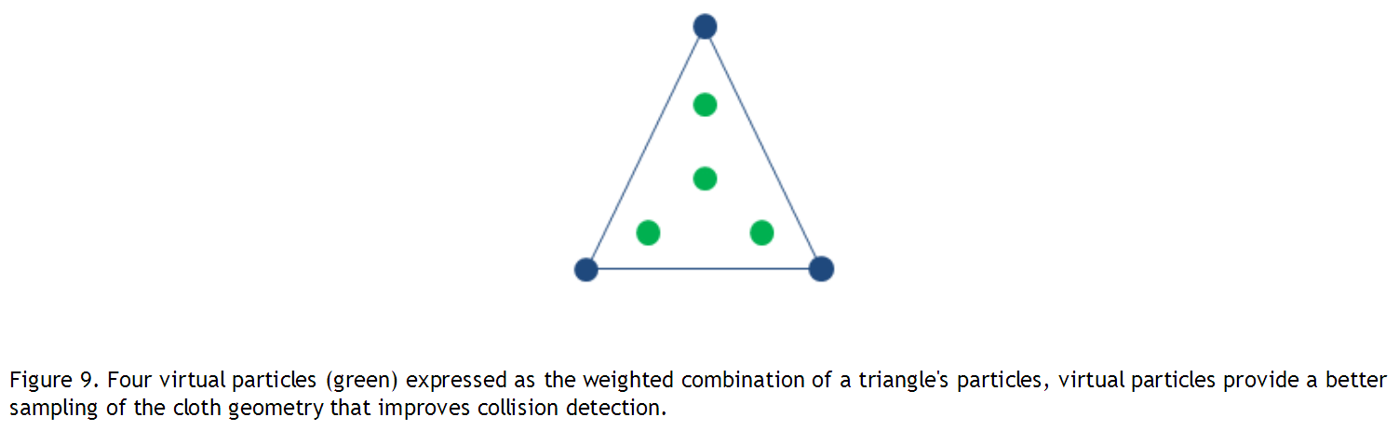

Slide 30
example
A virtual particle is defined by 3 particle indices and an index into a weights table, the weights table defines the barycentric coordinates used to create a virtual particle position from a linear combination of the referenced particles
The following is an example weights table that can be used to create a distribution of 4 virtual particles on a triangle:

Slide 31
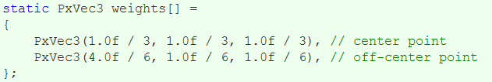

Slide 32
During collision processing each virtual particle is tested for collision like a regular particle and the collision impulse is redistributed back to the original particles using reverse interpolation.

Slide 33
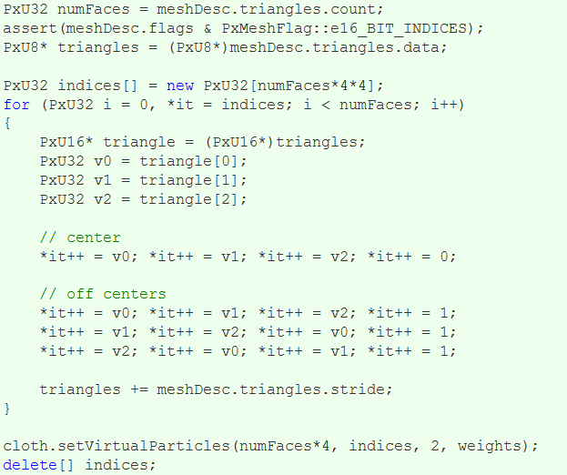
The code below shows an example of how to set up the virtual particles from a PxClothMeshDesc:

Slide 34
Accessing Particle Data
PxClothParticleData* data = cloth.lockParticleData(PxDataAccessFlag::eWRITABLE); float dt = cloth.getPreviousTimeStep(); for(PxU32 i = 0, n = cloth.getNbParticles(); i < n; ++i) { data->previousParticles[i].pos -= particleAccelations[i] * dt; } data->unlock();

